Slide 1
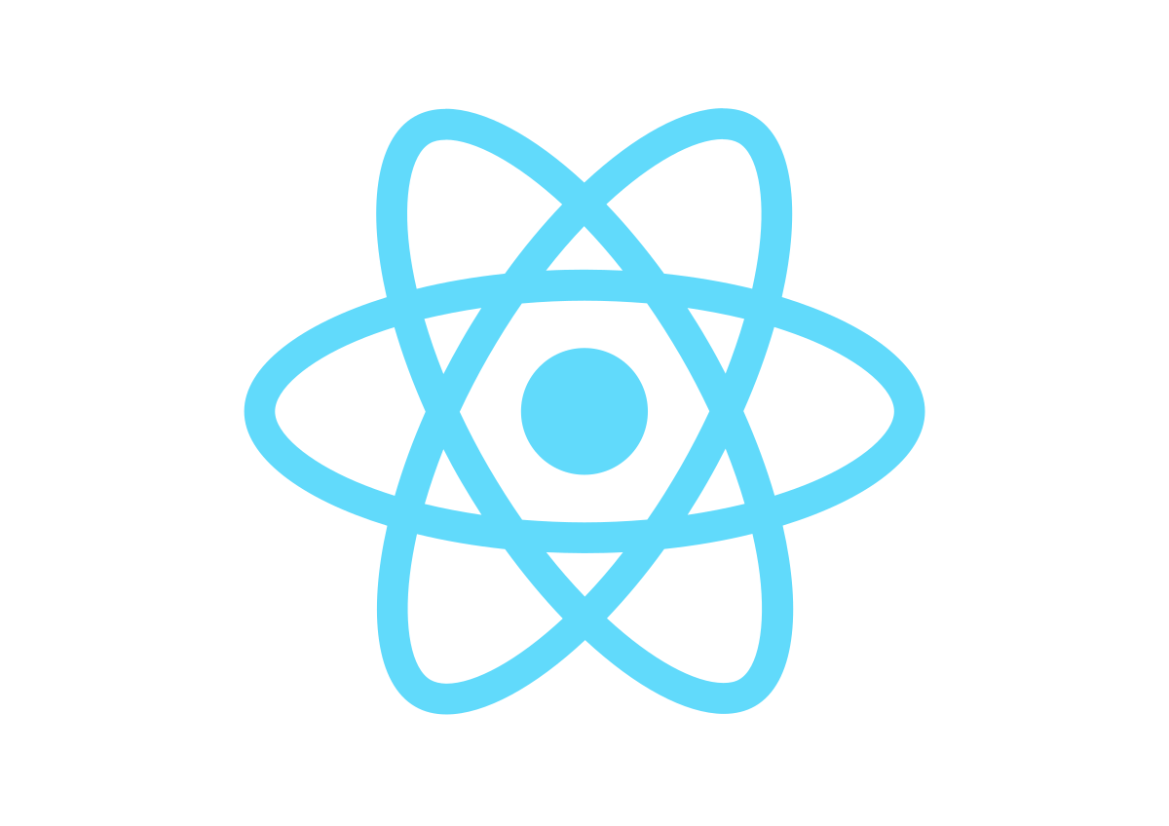
Day 3

Slide 2
Today’s Topics:
Introduction to React
Installing Visual Studio Code(code editor)
Installing Node and NPM
Create react application

Slide 3
Why React Js?

Slide 4
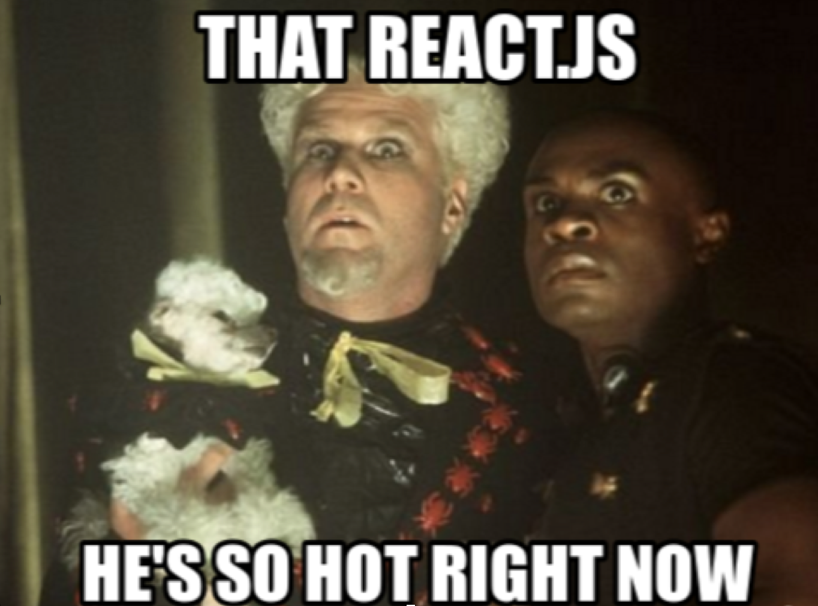

Slide 5
React Overview:
JavaScript library
Library for creating user interface
Maintained by Facebook
Open-Source in May 2013
Motto – ” Learn once write everywhere”
“V” in the “MVC”

Slide 6
React Features

Slide 7
Create reusable UI components

Slide 8
Virtual DOM
Keep track of state in DOM is hard.
It’ll be so easier to re-render thee whole Dom on every change.
Unfortunately the DOM API is not so fast.

Slide 9
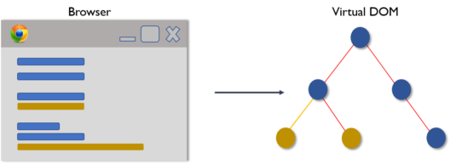
Virtual DOM

Slide 10
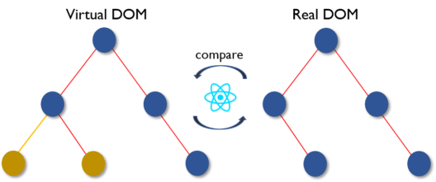
Virtual DOM

Slide 11
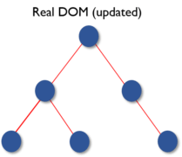
Virtual DOM

Slide 12
JSX:
React components are written in JSX, a JavaScript extension syntax allowing easy quoting of HTML and using HTML tag syntax to render components.

Slide 13
One way Data Flow:
The only to pass data through different components is from top to bottom. No two way bindings.

Slide 14
Company using React
Facebook
Amazon
Netflix
Airbnb
Twitter
Yahoo
Dropbox
And many more

Slide 15
Node??
A runtime environment for executing JavaScript code.
runtime environment?
Before node we use JavaScript to build application which only runs on browser.
Every browser has JavaScript engine which takes js code and converts to machine code.
Microsoft edge – chakra
Firefox – spiderMonkey
Chrome – v8
Js code can behave differently in different browser

Slide 16
Node??
Ryan Dahl, creator in 2009
Execute js outside of browser
Node is a JavaScript runtime build in chrome v8
Single thread
We often use Node to build back-end services(API)
Node.js uses an event-driven, non-blocking I/O model that makes it lightweight and efficient.

Slide 17
NPM?
Node Package Module
All npm packages are defined in files called package.json.

Slide 18
Creating React Project
(npx create-react-app projectname)
projectname is a project name that you given for your react project.

Slide 19
Thank You

